Slide 1






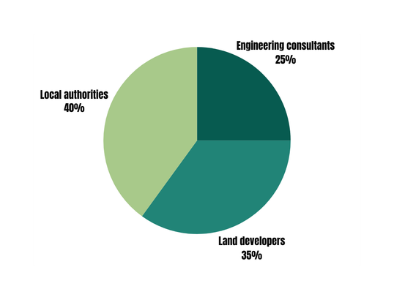
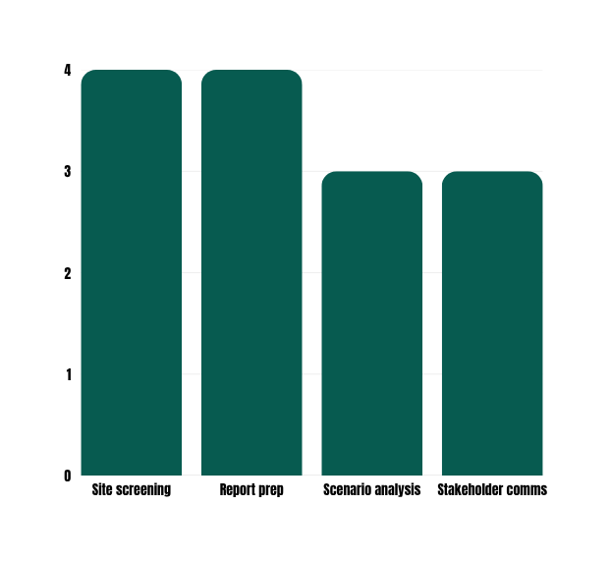

GIKNGO
AI-POWERED PREDICTIVE FLOOD INTELLIGENCE FOR SMARTER DEVELOPMENT PLANNING
PROJECT SUPERVISOR: TS. NURZEATUL HAMIMAH BINTI ABDUL HAMID
PREPARED BY MUHAMMAD LUQMAN NURHAKIM BIN ROSLI, BATRISYIA AFRINA BINTI RISAMUDDIN, NADYIE AZIL BIN NAZERI
INSTITUTION: FACULTY OF COMPUTER AND MATHEMATICAL SCIENCES, UNIVERSITI TEKNOLOGI MARA |
URBIEE NO.: BST03 | CATEGORY B UITM STUDENTS
ABSTRACT
OBJECTIVE
Flood risk assessment is a mandatory yet time-consuming step in development planning, requiring multiple datasets, specialized GIS tools, and significant technical expertise that are often inaccessible during early-stage planning. As a result, developers, local authorities, and consultants are frequently forced to wait for full technical studies before determining whether a site carries meaningful flood risk. Ginkgo was built to close this gap, specifically targeting urban flash flooding caused by intense rainfall and rapid urbanization. It is a web-based geospatial AI decision-support platform that combines a Flood Risk Prediction model and an Impervious Surface Detection model with GIS spatial analysis (elevation, slope, flow accumulation, river proximity) to generate predictive scenarios under normal, heavy rain, and extreme rain conditions. The system outputs a flood risk classification, site suitability rating, and preliminary OSD estimate through an interactive map, dashboard, and exportable report to help planners identify risk earlier and make smarter development decisions.
  Enable faster, Al-assisted early screening of flood risk and site suitability using official satellite / geospatial data
  Integrate Al-based flood prediction and impervious surface detection with GIS spatial analysis into a single decision-support platform
  Support land developers, local authorities / urban planners, and engineering consultants with actionable, early-stage planning insights
  Model flood risk under multiple rainfall scenarios (Normal, Heavy Rain, Extreme Rain) for more informed decision-making
USEFULNESS & COMMERCIALISATION POTENTIAL
  Speeds up early-stage flood risk screening, flagging high-risk sites instead of waiting weeks for a full technical study
TARGET ADOPTER SEGMENTS
WHERE GINKGO REDUCES EFFORT
Positioning, not measured market share
Illustrative, not benchmarked results
  Makes complex satellite and geospatial data usable by non-GIS specialists through one interpretable output
  Enables side-by-side comparison of flood risk across rainfall scenarios in a single interface
ENGINEERING CONSULTANTS - 25%
LAND DEVELOPERS - 35%
LOCAL AUTHORITIES - 40%
CONCLUSION
The findings substantiate the proposed theoretical revisions regarding systemic functionality. Implementing these revised frameworks will significantly optimize future research trajectories. Collaborative efforts across academic disciplines are essential to fully integrate these methodologies and address emerging challenges effectively throughout the coming decade.

